Slide 1
cs414 Rollerball Domain model
Team Name : String Cheese
Members : Tim Stroup, Chris Schaffer,
Meetkumar Savaliya, Ya-Hsin Cheng, Wei Chen

Slide 2
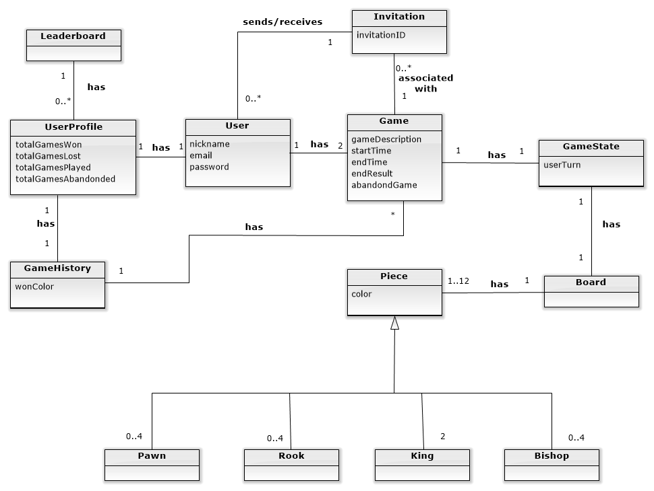

Slide 3
Glossary
Leaderboard
UserProfile
GameHistory
User
Invitation
Game
GameState
Board
Piece

Slide 4
Cahnges of Usercases

